Slide 1


Midterm Presentation: Human Robotic Arm Attachment
Los Alamos National Laboratory 2/26
Team: Dalton Boeckmann, Izzy Baumler, Jade Waldron, Morgan Gullo

Slide 2
Agenda
Introduction
Problem
Customer Needs
Analysis of Design
Balance of Semester Plan
Conclusions
Notes:
Our project is focused on developing a robotic arm solution to manage the radioactive waste stored at the Hanford Site in Washington State. This site has accumulated over 56 million gallons of waste stored in tanks that have far exceeded their intended lifespans. With the tanks now deteriorating, this poses serious environmental risks to local communities and ecosystems.
Problem Statement: "Our challenge at the Hanford Site revolves around removing radioactive waste in extremely confined spaces and under high-radiation conditions. The tanks holding this waste were designed to last only 25 years, yet many have far exceeded that lifespan, making the risk of leakage a pressing concern. Current solutions lack the needed durability, access capability, and flexibility for handling the solidified waste."
Project Objectives: "Our team’s primary objectives are to create a robotic arm capable of high mobility, durability, and efficiency for use in these restricted environments. We’re partnering with Los Alamos National Laboratory to bring this solution to life, and we're targeting a design that addresses all these challenges without risking human exposure to radiation."
Solution Approach: "Our proposed solution is a six-degree-of-freedom robotic arm mounted on a quadruped robot. This setup provides the stability needed for operations on uneven surfaces within the tanks. The 6-DoF arm, with its human-like mobility, will maneuver effectively within confined spaces to tackle both the liquid and solidified waste, ensuring efficient and comprehensive cleaning operations."
Key Challenges: "There are several critical obstacles our team is addressing: limited access due to one-foot-diameter tank openings, high radiation levels that damage equipment, and the need for rapid, remote operation. Many existing robotic systems can either manipulate or move quickly but struggle to do both effectively in a confined space. This project aims to fill that gap by providing both mobility and precise control within these extreme conditions."

Slide 3
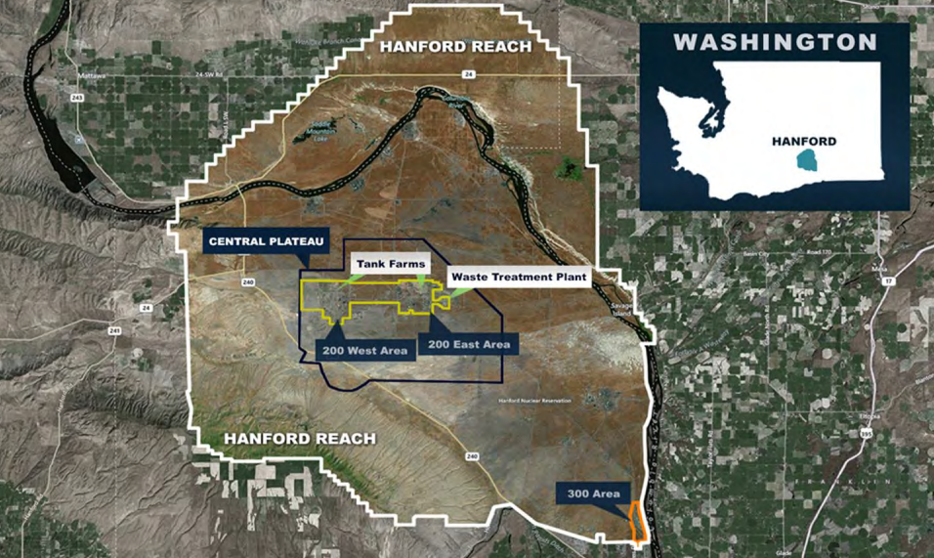
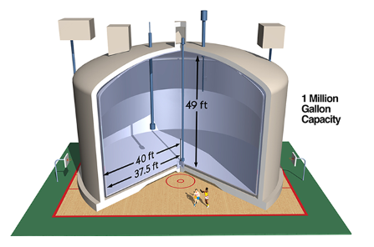
Problem Identification
Location: Hanford Site, Washington State
Background: 45+ years of plutonium production has led to 56 million gallons of hazardous and radioactive waste stored at the Hanford Site.
Problem: Original tanks designed for 25 years; most now exceed this, with approximately 68 tanks in critical condition.
Risk: High environmental and health risks due to tank deterioration, posing a growing threat to surrounding areas.
Notes:
Our problem takes place…. Over its 45 years of plutonium production, the Hanford Site in Washington State has accumulated over 56 million gallons of mixed hazardous and radioactive waste. The waste was initially stored in tanks designed to last 25 years; however, most of these tanks have far exceeded their intended lifespans, with about 68 tanks reaching critical conditions. The state of these tanks poses an increasing threat to both local populations and infrastructure. Through the partnership with Los Alamos National Laboratory (LANL) and Texas A&M, our senior design team has been tasked to design and fabricate a solution for this problem.

Slide 4
Problem
I. Solution Neutral Problem Statement
II. Mission Statement

Slide 5
Solution Neutral Problem Statement
The Solution Neutral Problem Statement (SNPS) serves as the foundation for defining the project’s functionality and requirements.
By focusing on high-level project needs rather than specific solutions, the SNPS was derived.
The scope of the project and evolving custom requirements prompted regular revisions to the SNPS, ensuring ongoing alignment with project goals.
SNPS | There is a need for a technology that has 5 DOF and can move through its full range of motion in each degree of freedom of at least 1 Hz.
Customers | Department of Energy, National Research Laboratories
Notes:
In order to keep the project streamlined, the team identifies a snps to serve as the foundation of the projects functionality and requirement
This was used by focusing on high level project needs rather than specific solution, in order to allow for maximum possible solutions
Due to neutreality of this statement, it made it easy for iterative revisions, to ensure ongoing alignment with project hgoals
Finally, tyo date our snps, is as stated …, There is a need for a technology that has 6 DOF and can move through its full range of motion in each degree of freedom around 1 Hz.

Slide 6
Mission Statement
Mission statement to clarify the LANL project team’s design goals, aligning with both design team and customer needs.
The mission statement specifies that the LANL project team will design and prototype a 5 DoF robotic arm.
Mission Statement: Human Robotic Arm
Product Description | Design a 5 DoF robotic arm with human like functionality
Key Business or Humanitarian Goals | Effectively clean nuclear waste from Nuclear Waste Tanks to prevent contamination of local environments and populations Successfully Prototyped and Fabricate Robotic arm within 8 months
Primary Market | Department of Energy
Secondary Market | US Government, US Military, Nuclear Energy
Assumptions | We can assume: that the robot can withstand harsh radioactive environments, the robot can handle large amounts of force without tipping over, the robot can handle large amounts of force without damaging the tank wall, and visibility will allow for sensors to determine if plutonium is being removed, we assume the material is a hard tar heel substance
Stakeholders | Washington Citizens, National Research Labs, Department of Energy
Avenues for Creative Design | Material, robotic actuation for arm movement and control, Semi-Autonomous
Scope Limitations | Resources, only 4 group members, only 8 months to work on it, Size limits, Force limits to protect the tank, Material selection, Dynamic capabilities
Notes:
Material selection for durability and performance, robotic actuation for speed and efficiency, and semi autonomous control system improved usability
Given limited resources and timelines, the team chose to prioritize the mechanical aspects of the design, specifically focusing on optimizing the speed and dynamic capabilities of the manipulator.

Slide 7
Customer Needs
Supplemental Design Survey
Customer Interviews
Customer Needs
Needs Analysis

Slide 8
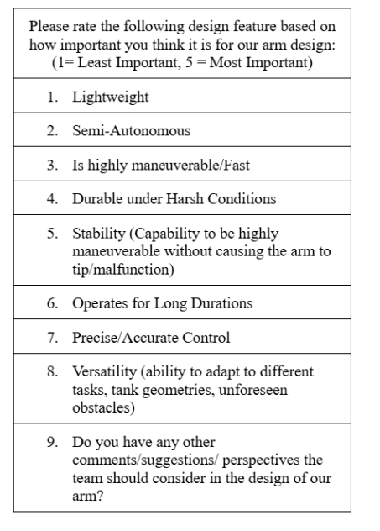
Supplemental Design Survey
13 Respondents of various backgrounds in industry

Slide 9
Customer Interviews
Question | Customer Statement (Rodrigo Ramon) | Customer Statement (Michael Tomlin) | Interpreted Need | Weight | Activity
What specific motions would you expect the robot /robotic arm to handle on a regular basis? (Movement, force) | The robot should be capable of moving back and forth over a specific area during cleaning operations. | The robot needs to perform sweeping motions and accurately identify the edges of curved surfaces on the wall, requiring mathematical precision to navigate these arcs effectively. | The robotic arm must be able to perform repetitive back-and-forth movements over designated areas while also executing sweeping motions to ensure thorough cleaning. | 3 | Executing precise movement patterns to clean specified areas and navigate curved wall surfaces effectively.

Slide 10
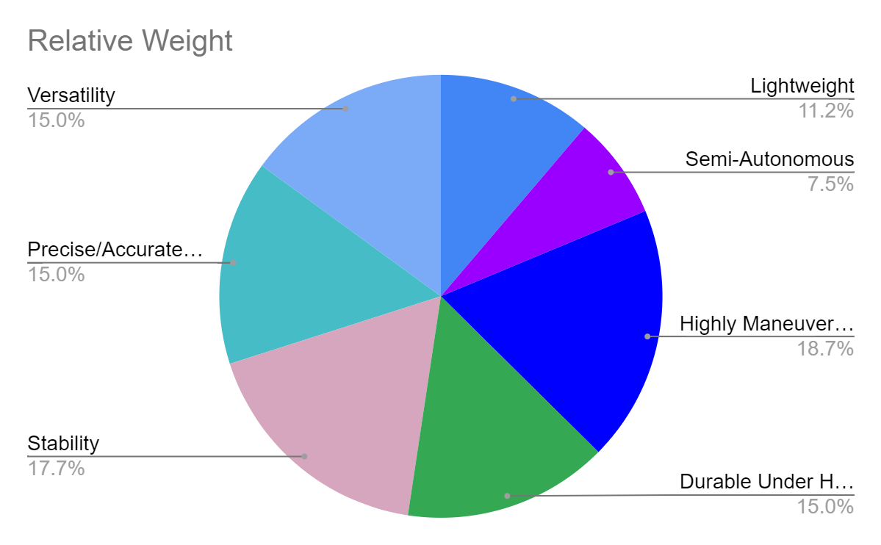
Customer Needs

Slide 11
Customer Needs
Employed various methods, including preliminary research, customer interviews, and supplemental design surveys to identify and rank critical needs
# | Designated Need | Importance Score (1 to 5, 5 = most important)
1 | Highly Maneuverable/Fast | 5
2 | Precise/Accurate Control | 4
3 | Versatile | 4
4 | Durable under harsh conditions | 4
5 | Stable | 4
6 | Lightweight | 3
7 | Semi-Autonomous | 2

Slide 12
System Description
J1 Subassembly
J2 Subassembly
J3 Subassembly
J4 Subassembly
J5 Subassembly
Material Selection
Fastener Selection
Electrical Selection

Slide 13
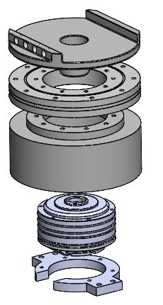
J1 Subassembly
Holds motor and bearing vertically to handle high torque loads
Five components: Motor Holder, Mushroom Cap, Motor Cover, Motor, Cross Roller Bearing
Cross-roller bearing reduces friction and distributes load to prevent motor shaft failure
Uses clearance fit holes (M4-M6) for easy assembly
Adjusted hole tolerance from 0.4mm to 0.6mm for better fastener fit

Slide 14
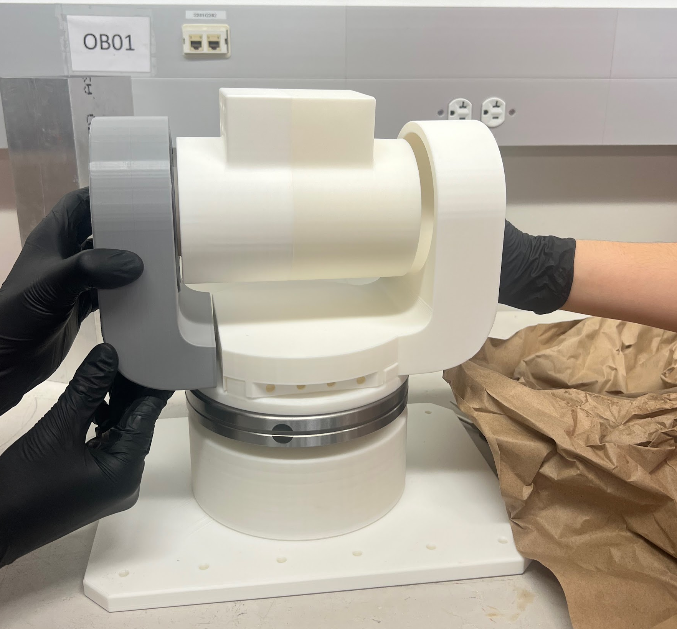
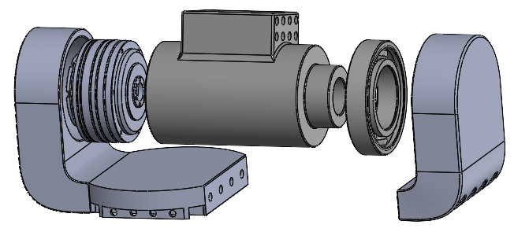
J2 Subassembly
Provides up-and-down movement to expand the arm's workspace
Motor and bearing mounted on opposite sides of a cylinder for connection
Five components: Motor Holder, Motor, Ball Bearing, Bearing Holder, Cylinder
Essential for reaching different heights without repositioning the base

Slide 15
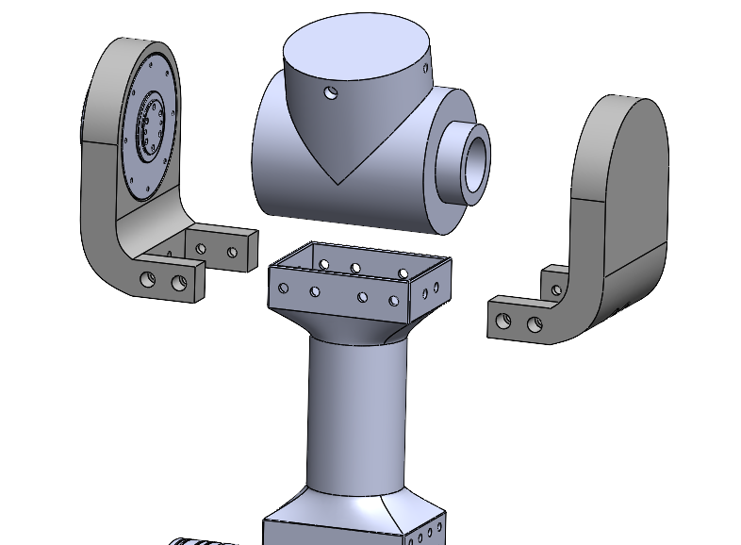
J3 Subassembly
Functions like a human elbow for vertical movement
Six components: Bicep, Motor Holder, Motor, Ball Bearing, Bearing Holder, Cylinder
Uses a similar design to J2 for simplicity
Smaller motor and bearing due to weight constraints
Enhances dexterity and efficiency in robotic motion

Slide 16
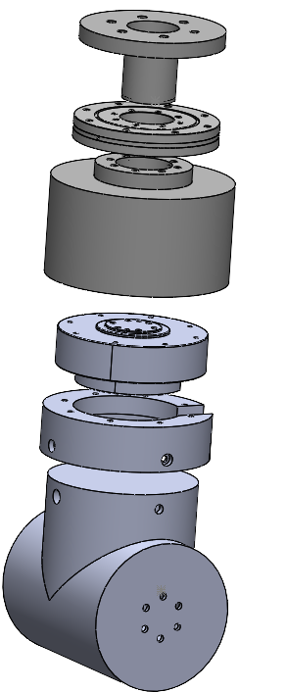
J4 Subassembly
Enables rotational movement similar to a human elbow
Five components: Motor Holder, Motor Cover, Cross Roller Bearing, Mushroom Cap, Motor
Similar function to J1 but connects to J3 Cylinder instead of the base
Uses the same motor as J3 for consistency

Slide 17
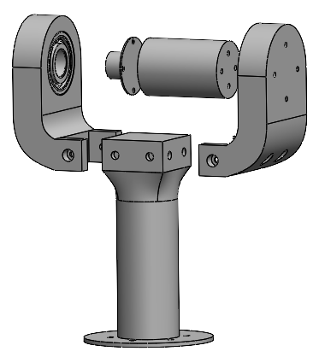
J5 Subassembly
Provides wrist-like up-and-down motion for fine control and dexterity
Seven components: Forearm, Motor Holder, Bearing Holder, Cylinder, Cylinder Cap, Motor, Bearing
Allows end-effector to tilt and interact with objects effectively

Slide 18
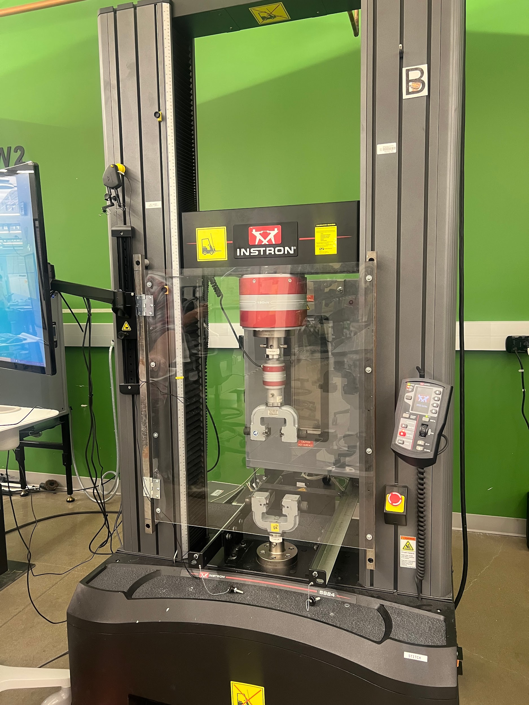
Material Selection
PLA: Used for prototyping due to ease of printing, low cost, and accuracy
PETG: Used for final build for increased strength, flexibility, and heat resistance
Experimental Procedure:
Measured the PLA sample with calipers
Set grips at 25 mm from each end of the sample
Set test speed to 5 mm/min
Measured elongation of sample after plastic deformation was reached

Slide 19
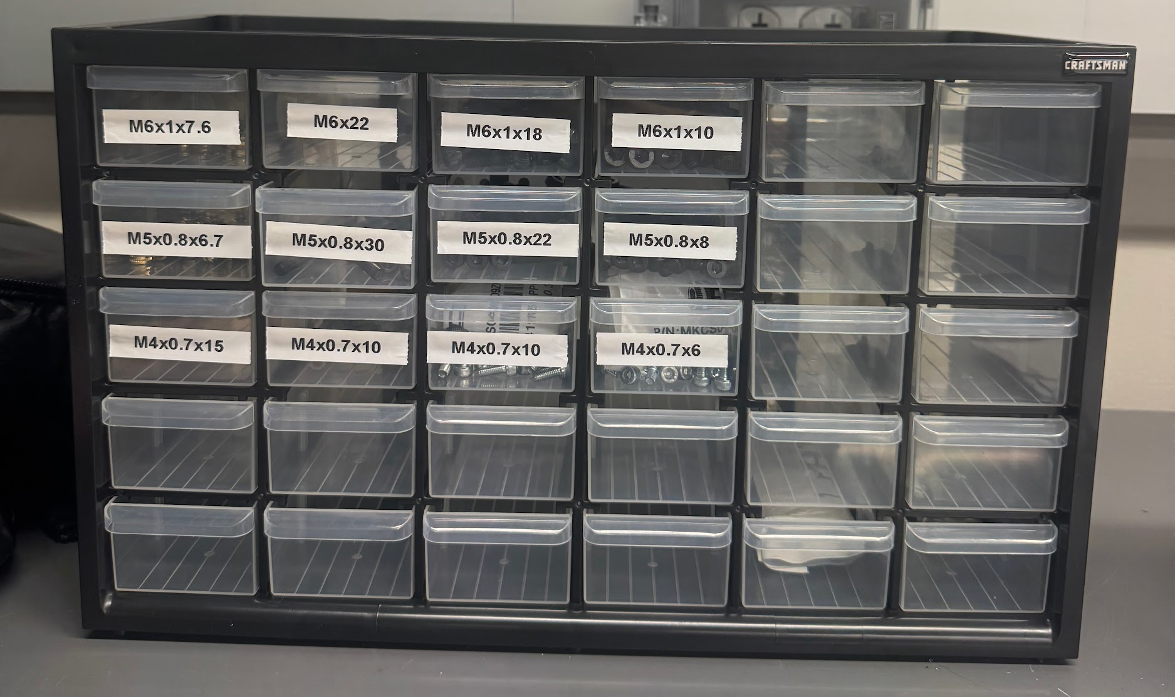
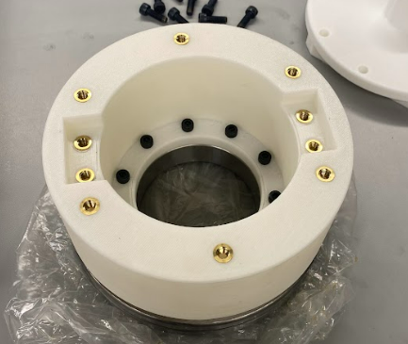
Fastener Selection
Constraints:
Motor Sizing (M2 - M6)
Cost Effectiveness
Vibrational Conditions
Identification of Socket Head Cap Screws
High tensile strength - (170,000 psi)
Applicable in High Torque environments
Compatible with heat set inserts in PLA to prevent loosening
Cost ~ 300$
Sizing ~ (M2 - M6) & (10 - 30 mm)
Tensile Strength ~ 170,000 PSI

Slide 20
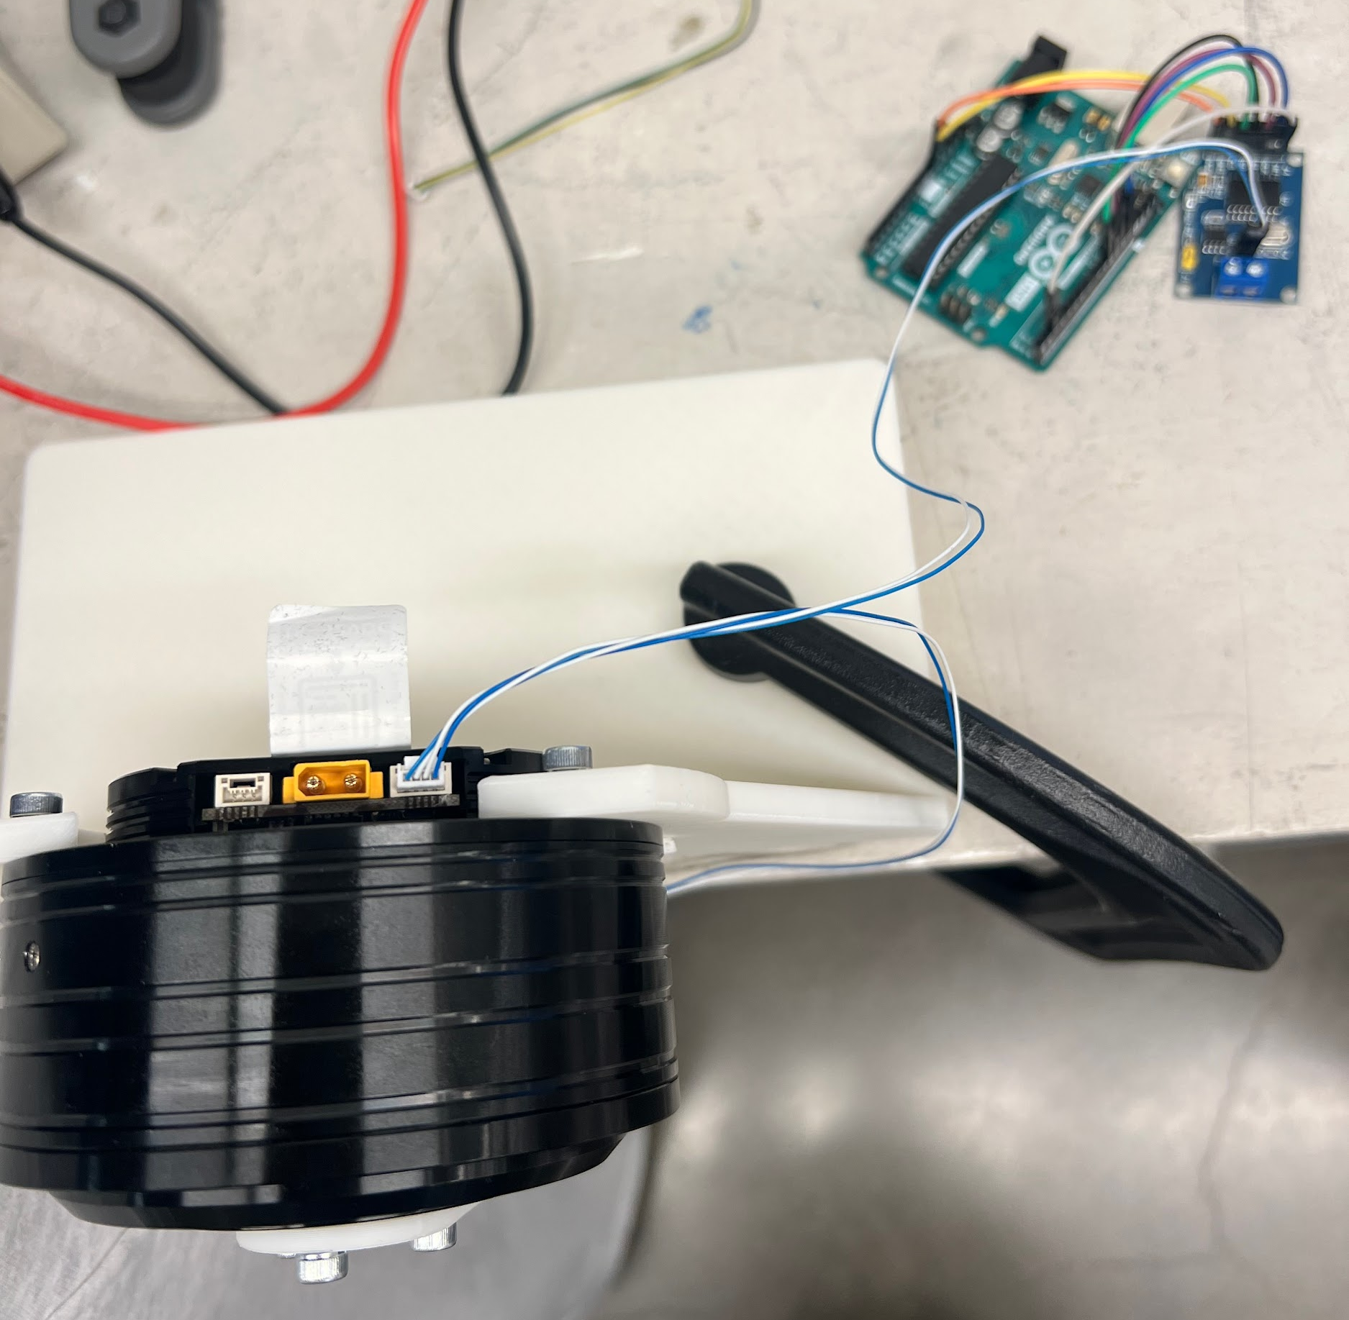
Electrical Selection
The team chose an MCP2515 CAN Bus and Arduino Uno for control design
This setup allows control of multiple motors from a central source
The system is controlled through the Arduino IDE using a variation of the C language
This setup provides robust communication, multi-device networking, and real-time performance

Slide 21
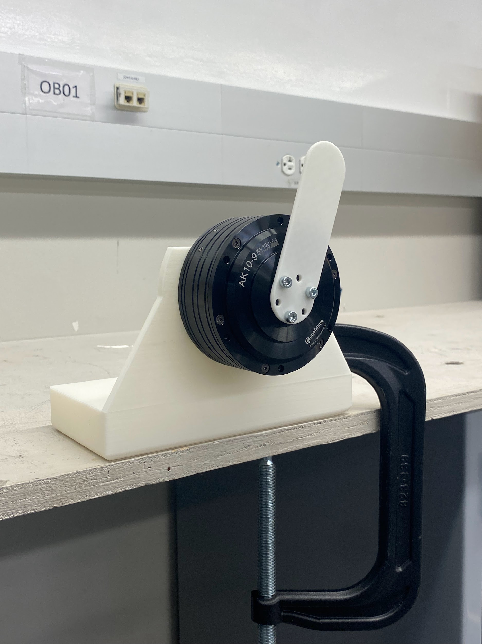
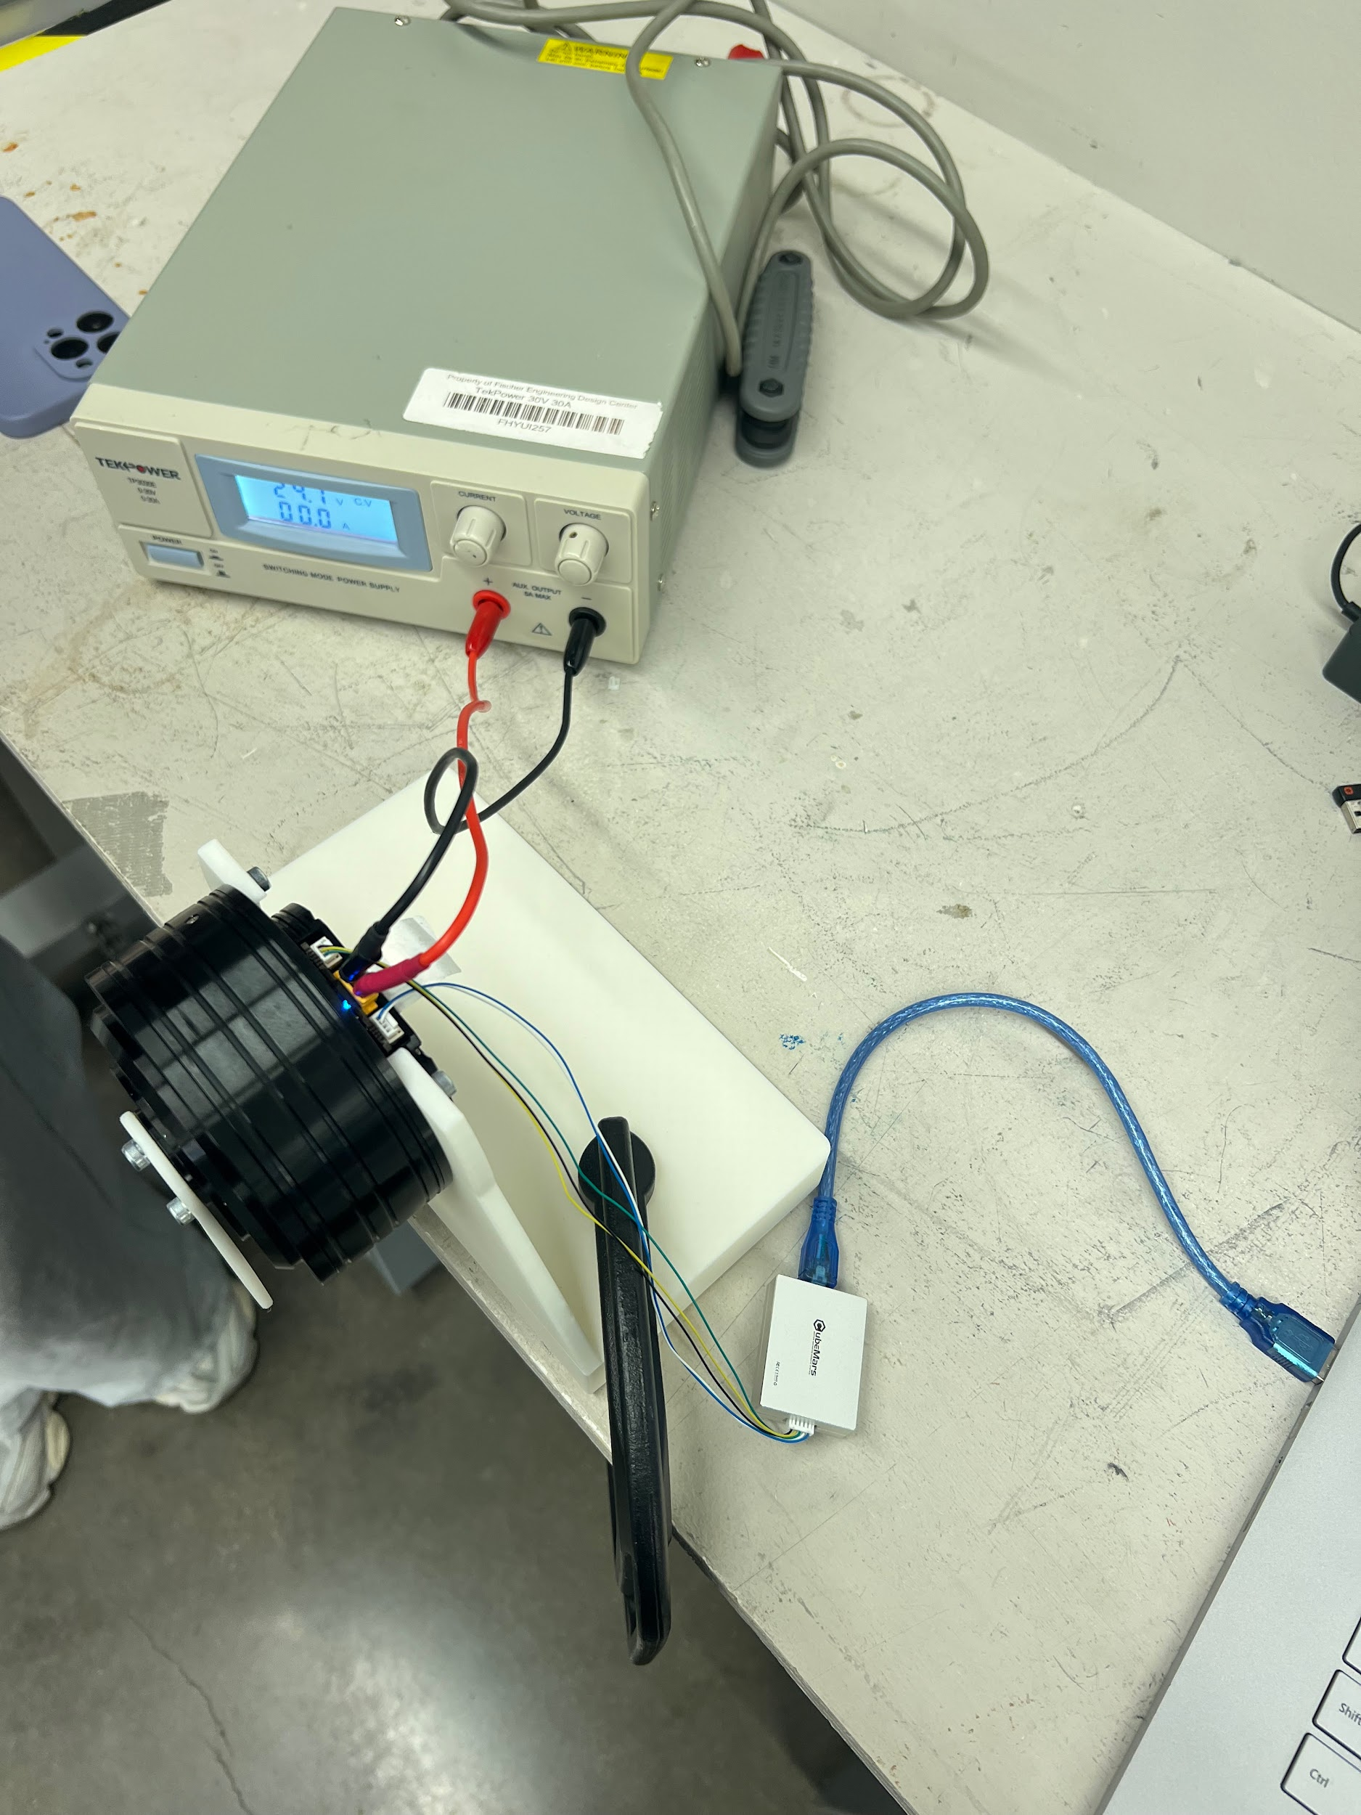
Electrical Selection
Implementation problems with the CAN Bus
Utilized a CubeMars device called “R-Link”
This device allows us to connect to the Upper Computer software that comes with the motors

Slide 22
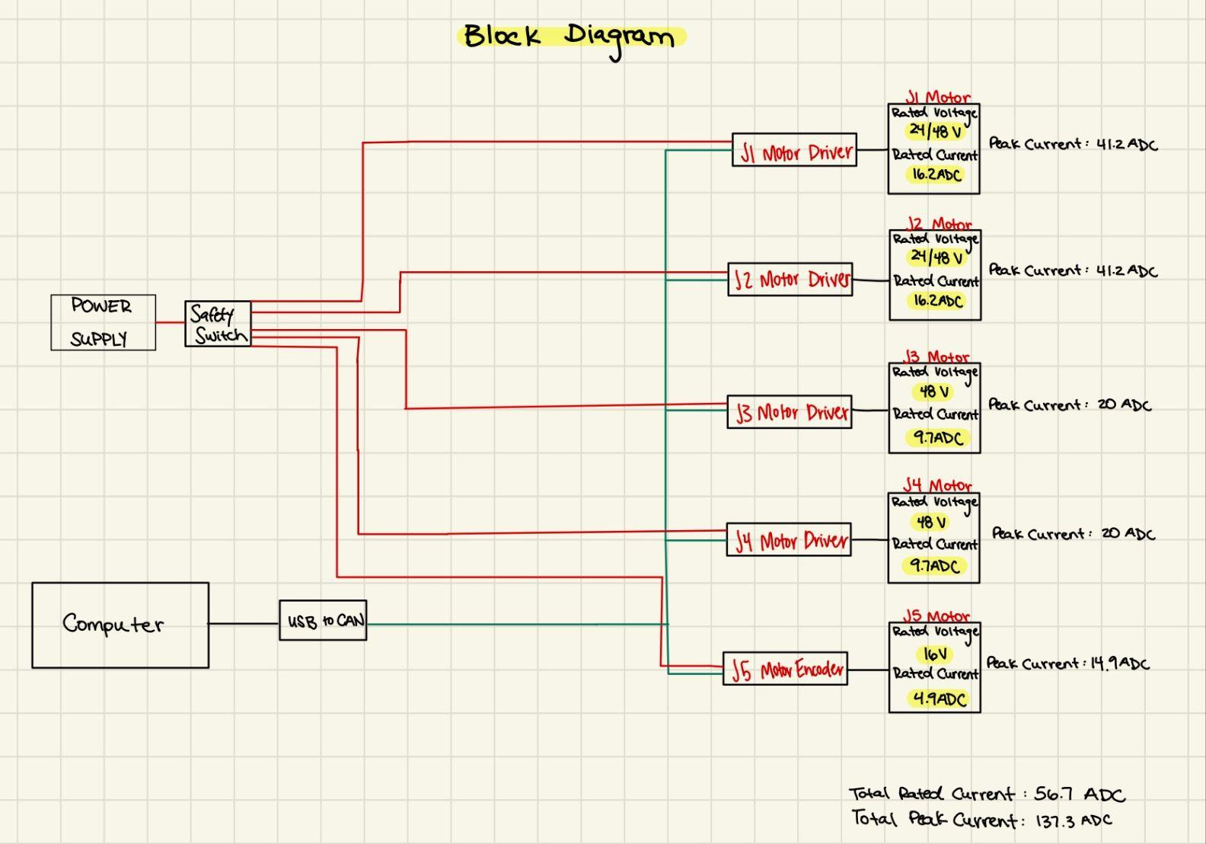
Electrical Selection

Slide 23
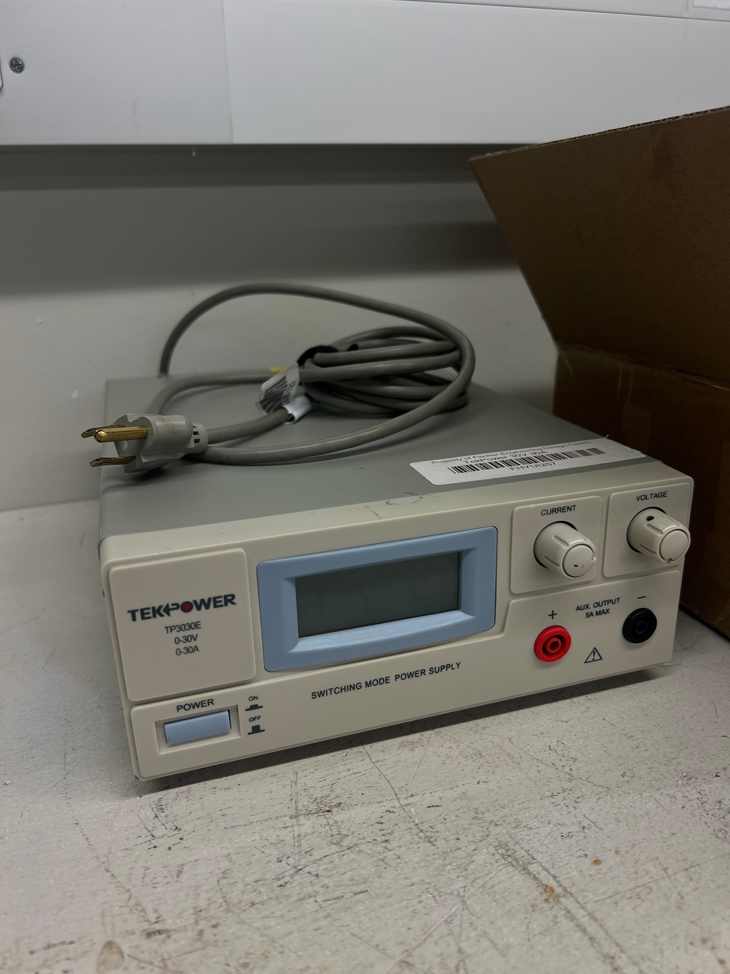
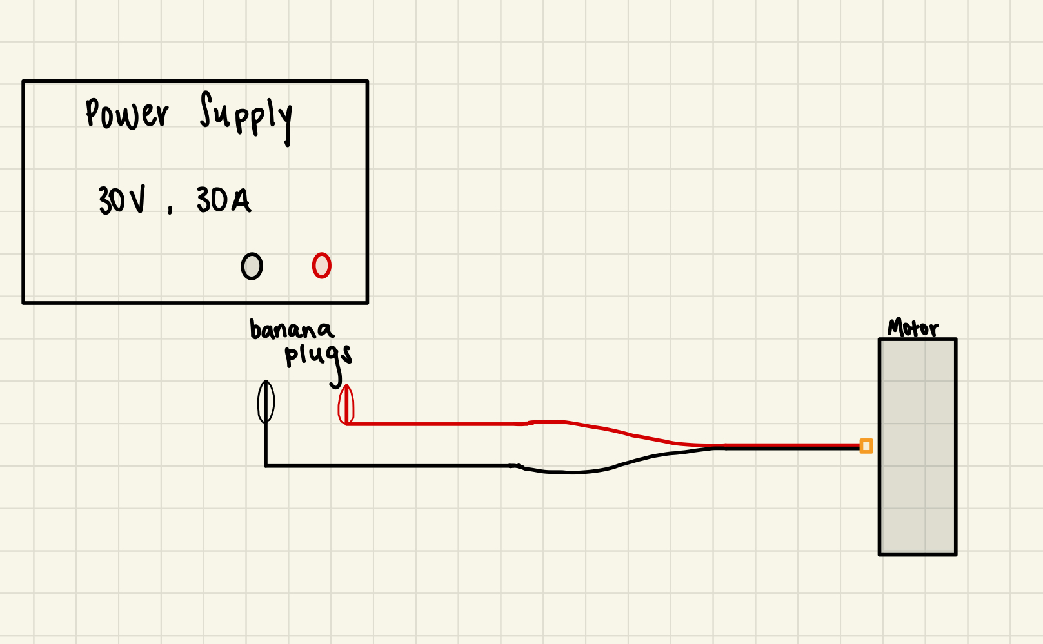
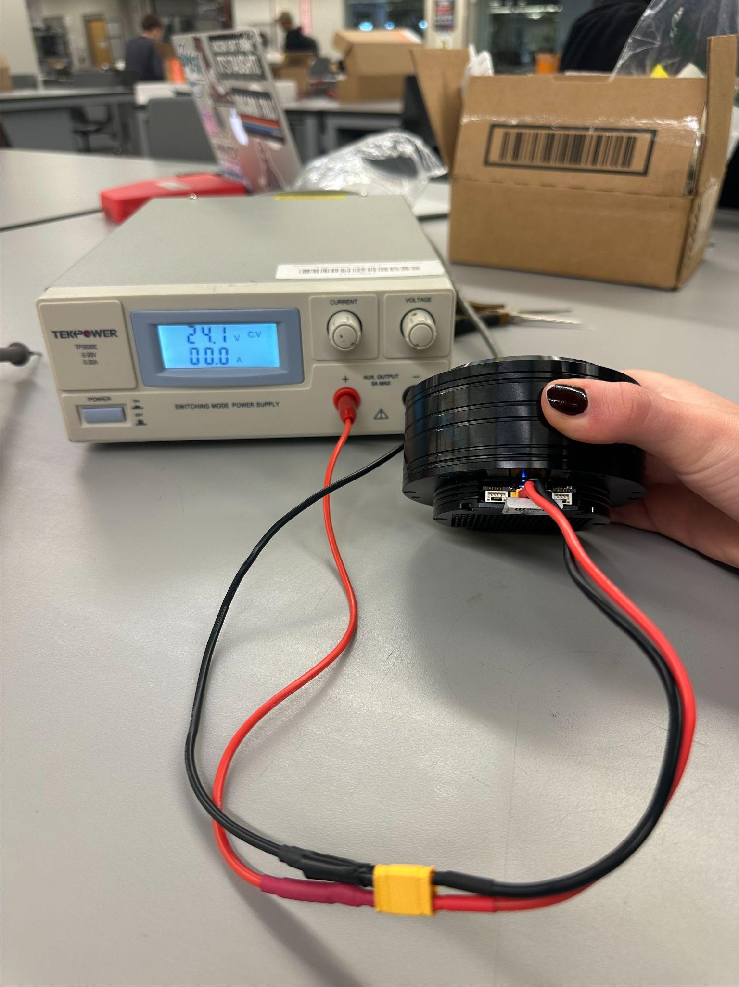
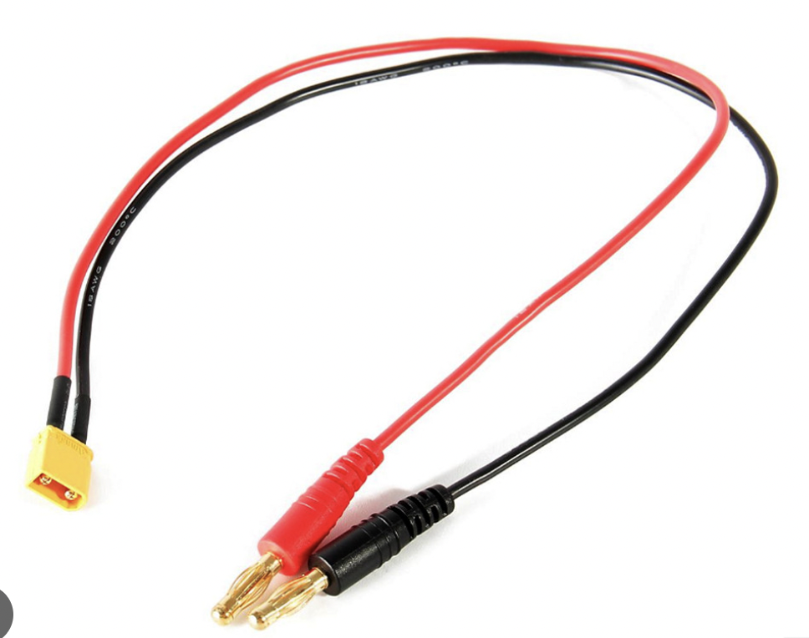
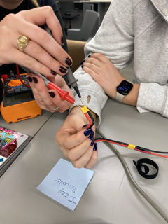
Electrical Selection
Preliminary Electrical Testing Setup

Slide 24
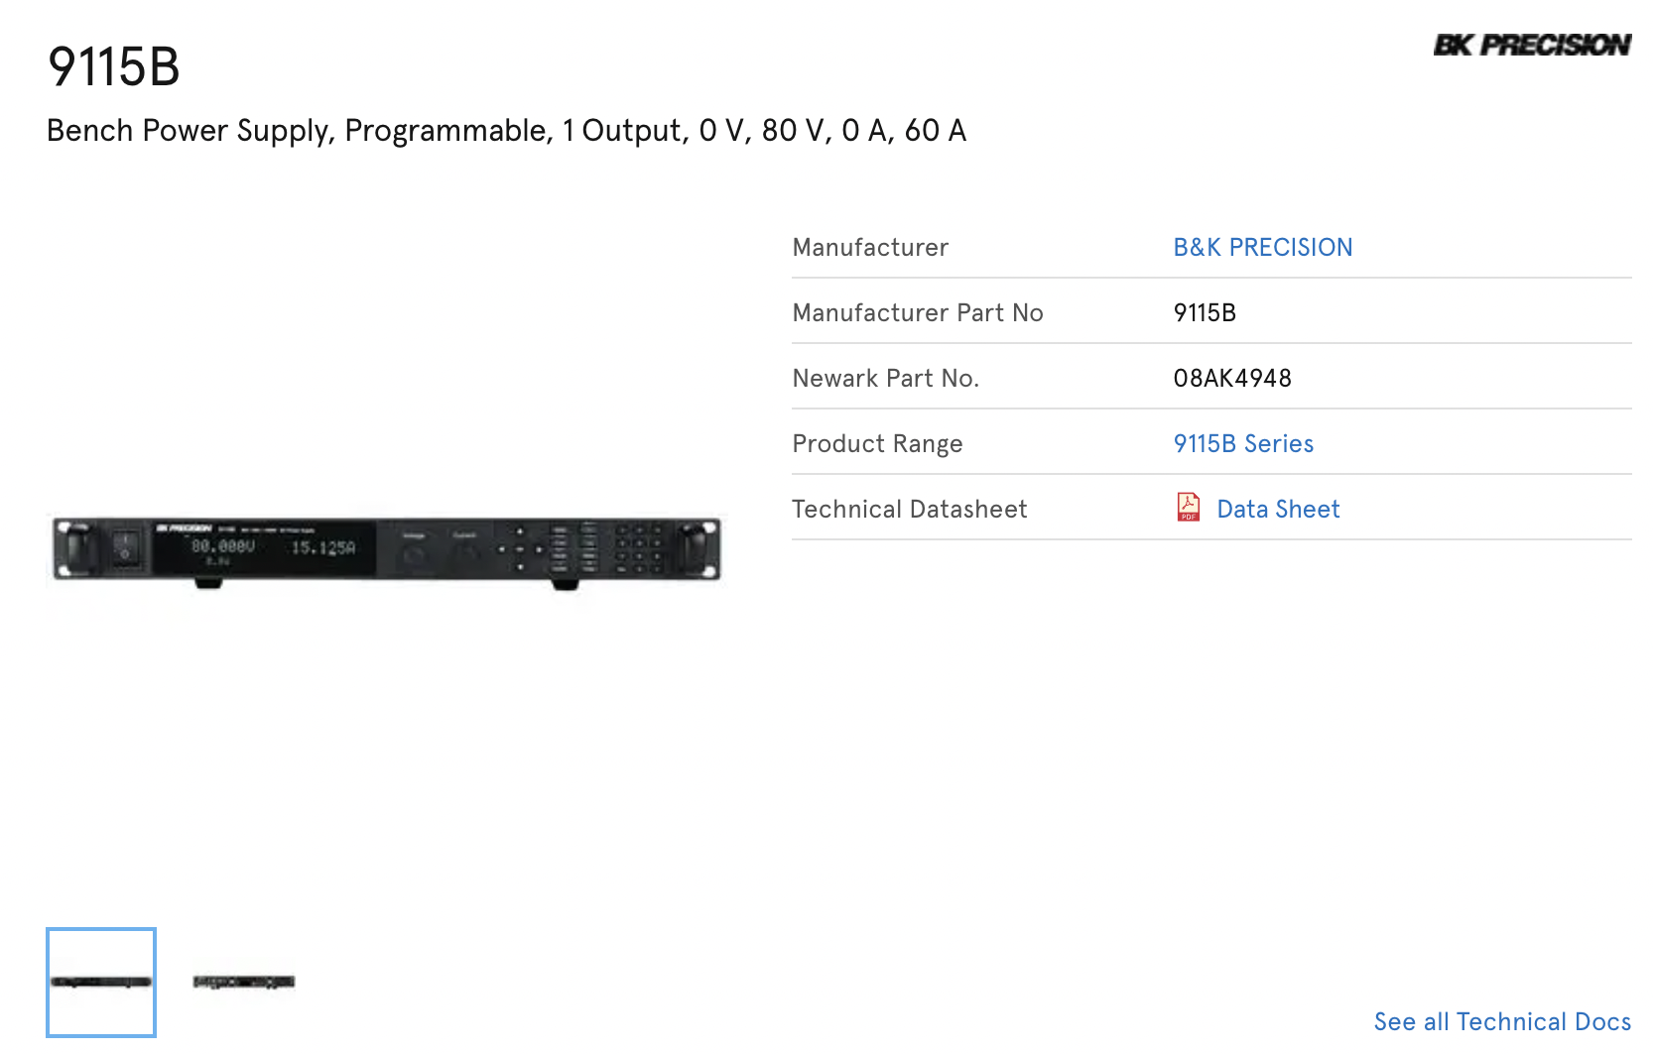
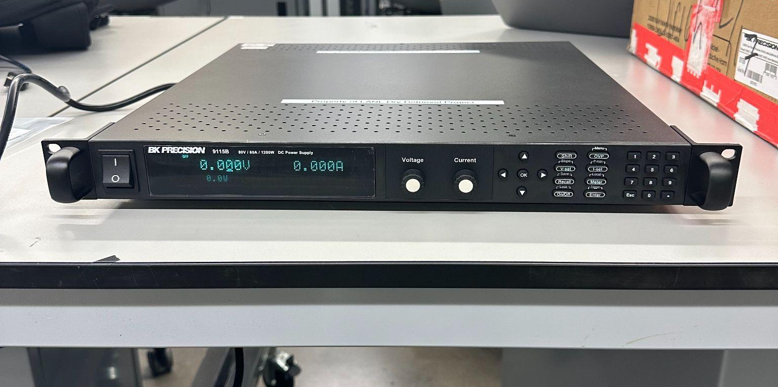
Electrical Selection

Slide 25
Analysis of Design
Logistical Challenges Faced
Embodiment Design Checklist
Risk Analysis (FMECA and FTA)
Design Validation
MEEN 401/402 Budget

Slide 26
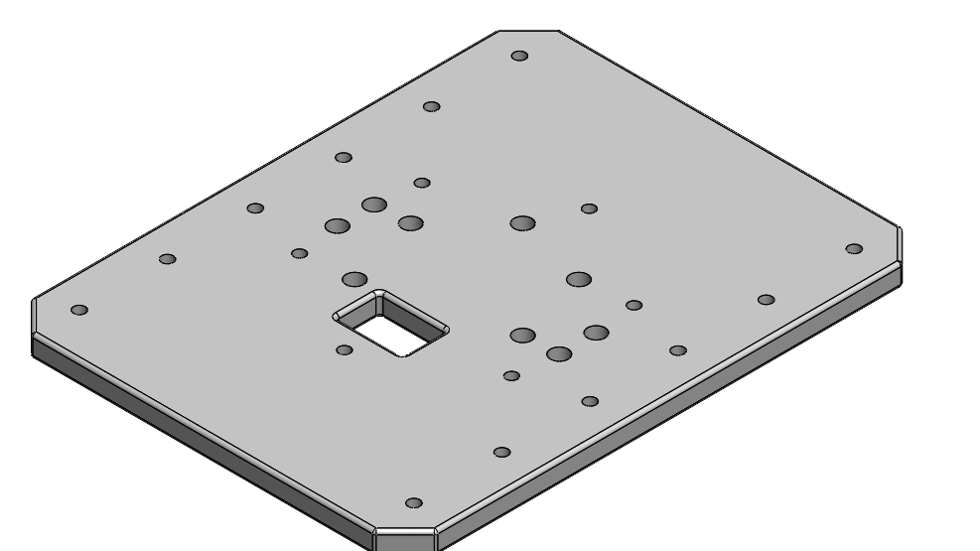
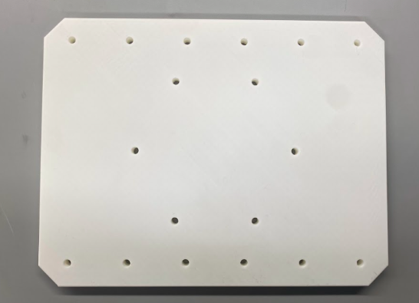
Logistical Challenges Faced
Design Complexity & Iteration:
Realization of design complexity during fabrication
Necessity for iterative redesign of components
Manufacturing & Assembly Issues:
Tolerance issues with threading PLA and heat-set inserts
Importance of infill percentage for 3D-printed part strength
Impact of print orientation on dimensional accuracy
Clearance problems with press-fit fasteners, requiring base redesign
NEW
OLD

Slide 27
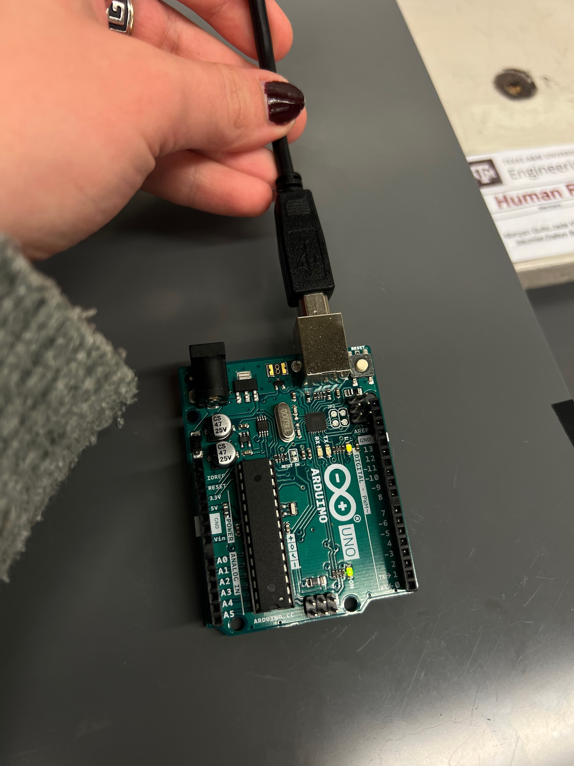
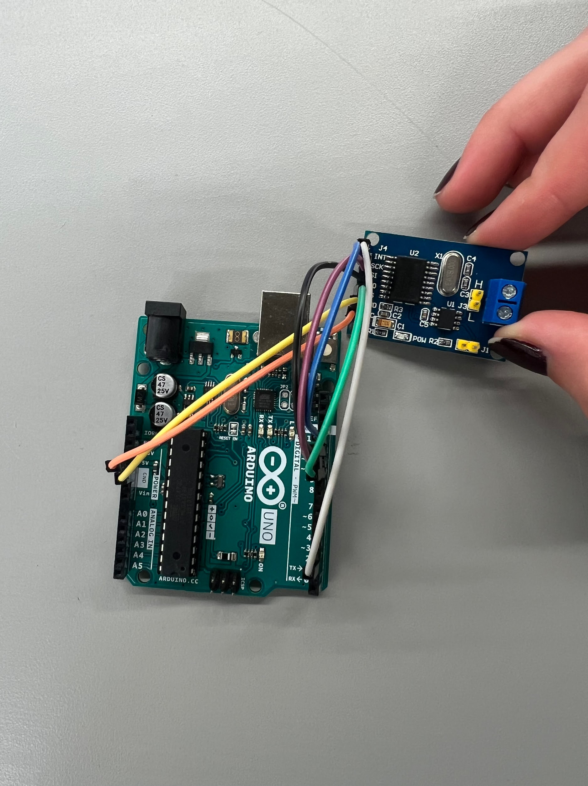
Logistical Challenges Faced
Motor Control Challenges:
Difficulties with Arduino to CAN Bus connection.
Limited C language expertise leading to control delays.
Successful individual motor testing via R-link and upper computer
Goal to continue to troubleshoot the Arduino to CAN connection
Budgeting & Outsourcing:
Unexpected tariff fees impacting project budget. (500$)
Cancel further foreign orders
Successful acquisition of components through LANL sponsorship

Slide 28
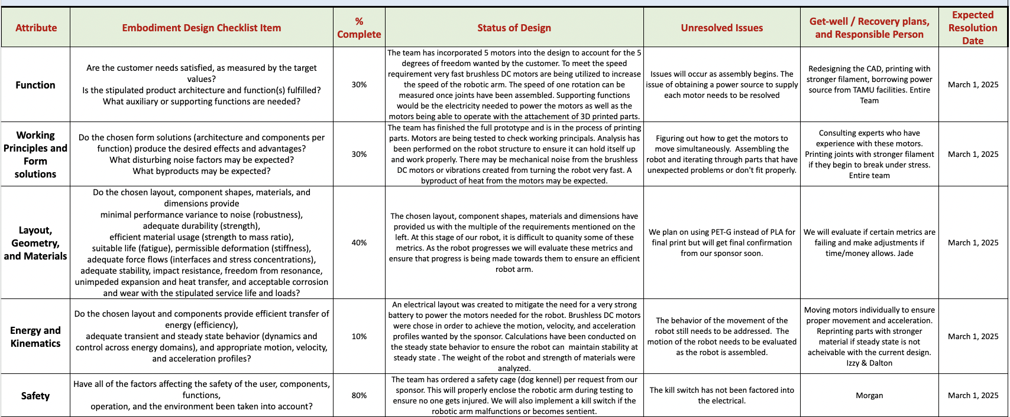
Embodiment Design Checklist

Slide 29
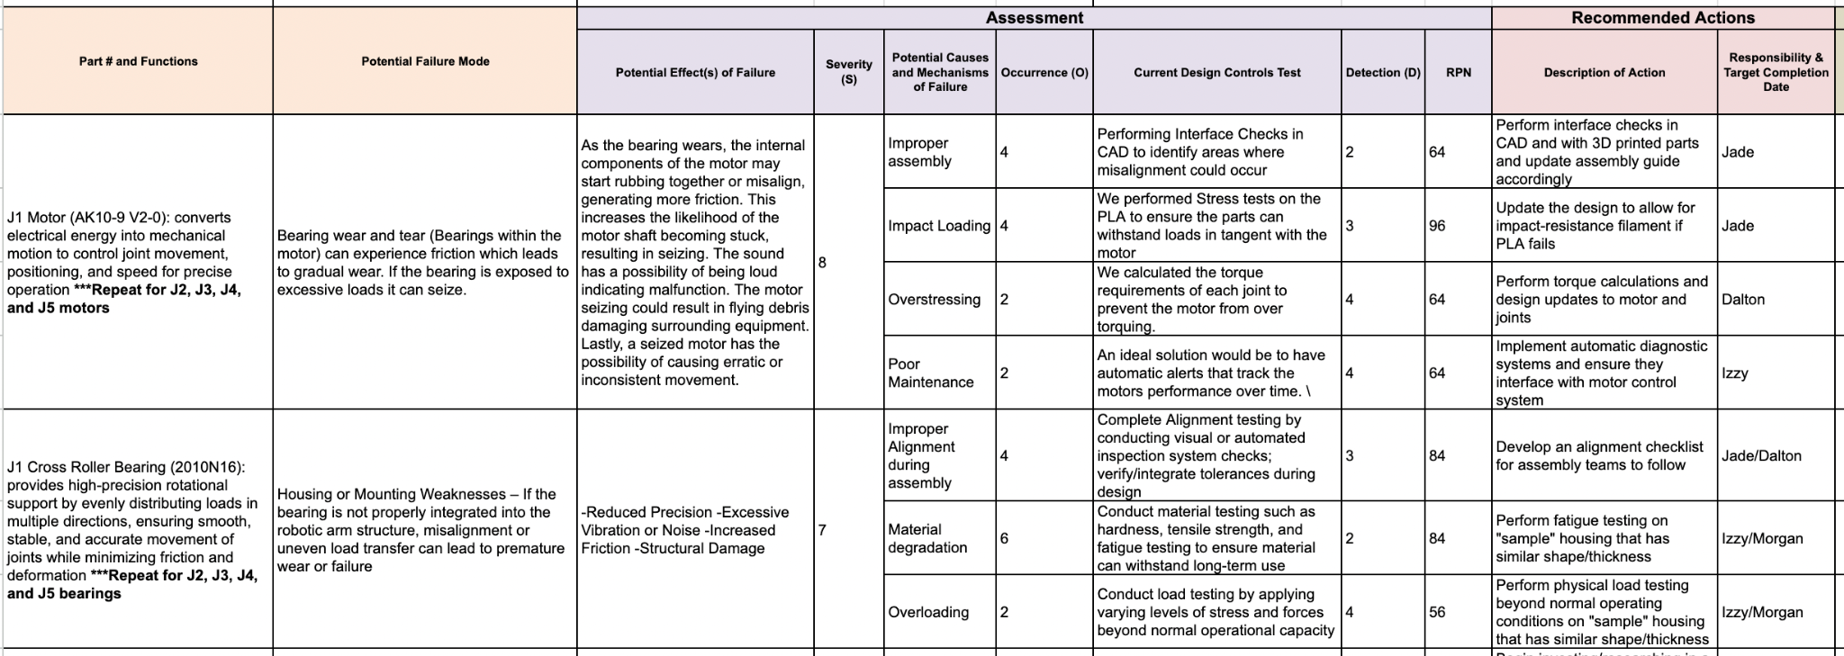
Failure Modes, Effects, and Criticality Analysis (FMECA)

Slide 30
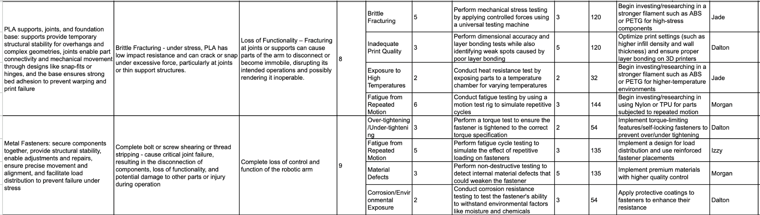
Failure Modes, Effects, and Criticality Analysis (FMECA)

Slide 31
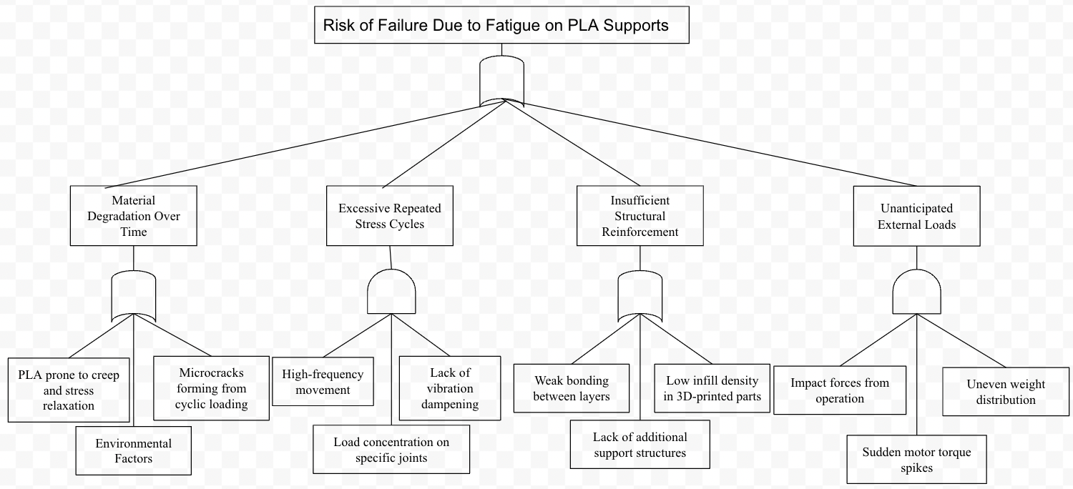
Fault Tree Analysis (FTA)

Slide 32
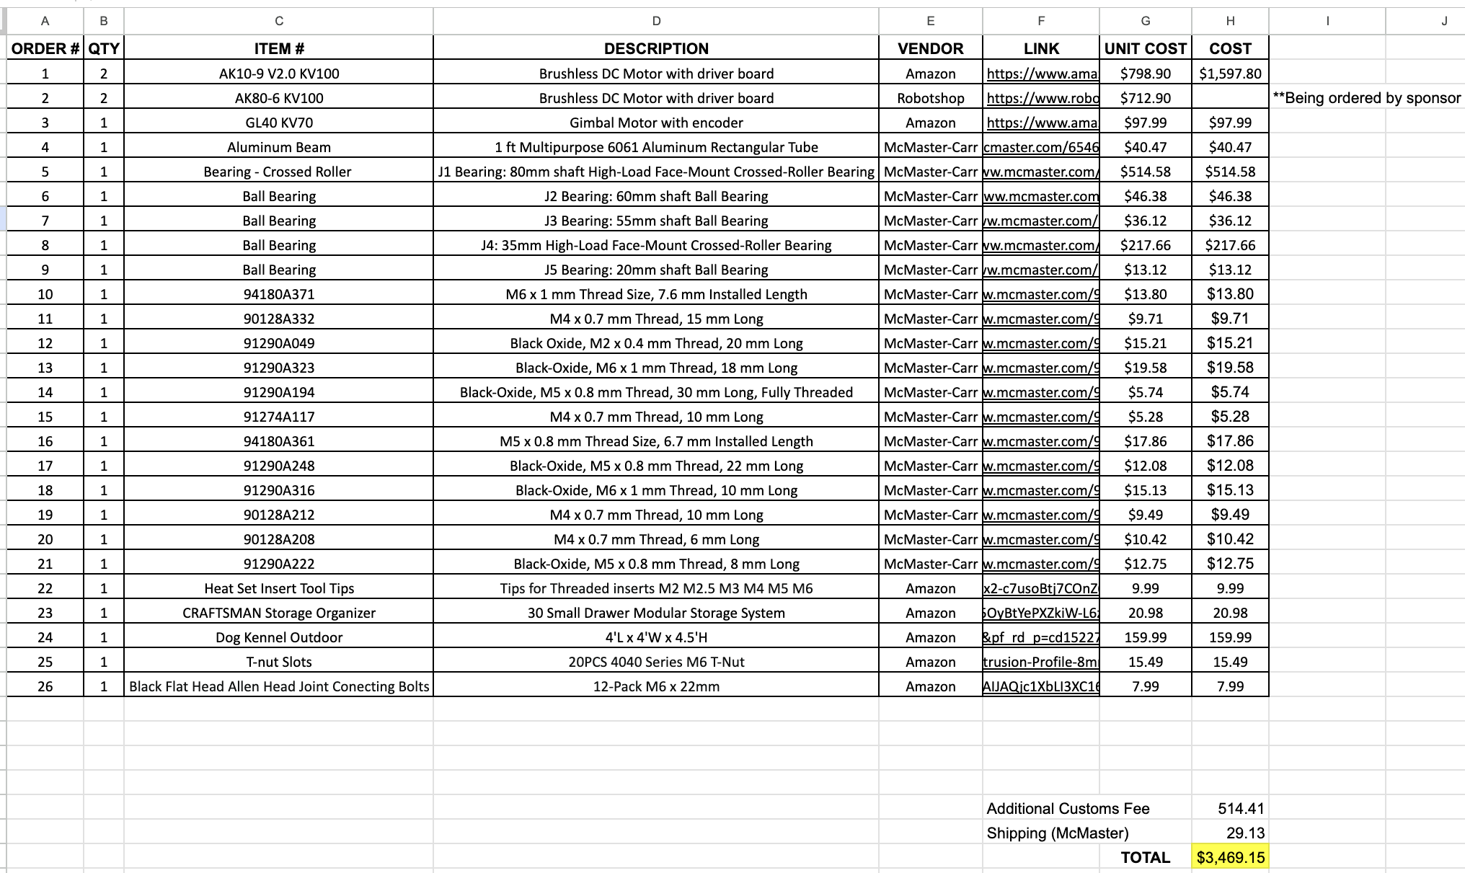
MEEN 401/402 Budget

Slide 33
Balance of Semester Plan
Expected Deliverables
Remainder of Embodiment Design
Timeline for Validation
Future Concerns and Mitigation Plan

Slide 34
Expected Deliverables
Fully assembled 5 DOF robotic arm prototype
SolidWorks CAD model of fully assembled 5 DOF robotic arm
Base and J1-J5 individual SolidWorks CAD assemblies and engineering drawings
Circuit block diagram of 5 DOF motor electrical design
Assembly Instruction Manual
Final Report outlining work performed in MEEN 402
Final Presentation outlining work performed in MEEN 402

Slide 35
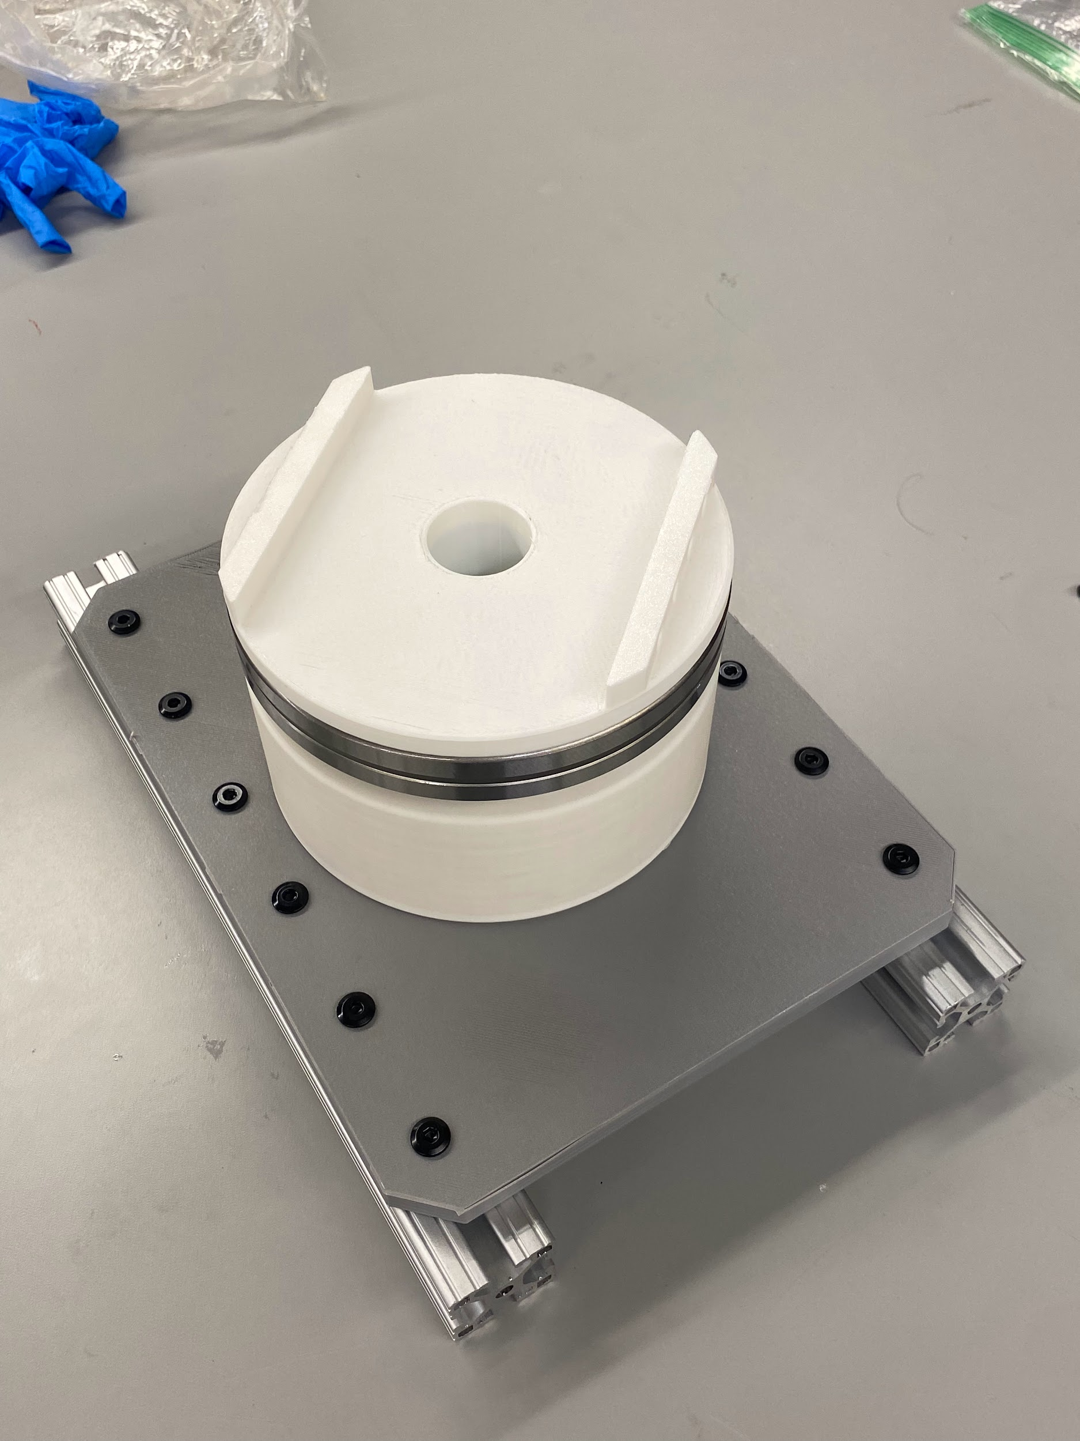
Fully Assembled 5DOF Robotic Arm Prototype
Overview
Fully assembled 5-degree-of-freedom robotic arm designed for speed
Built with 3D-printed linkages and CubeMars brushless DC motors
Progress
J1 and J2 linkages have been 3D printed
Heat set inserts have been soldered into the J1

Slide 36
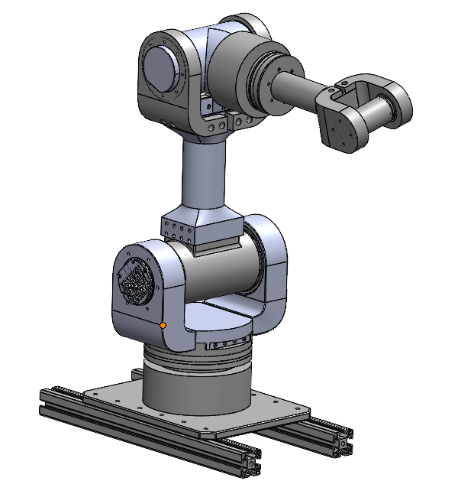
Solidworks CAD Model of Assembled Arm
Overview
Represents a fully assembled 5-degree-of-freedom robotic arm
Designed with realistic motion constraints and precise tolerancing for assembly
Progress
Continually changing as the team assembles each joint
The design is evolving as manufacturing challenges are discovered

Slide 37
Base and J1-J5 Individual Solidworks CAD

Slide 38
Circuit Block Diagram
Overview
Illustrates the electrical architecture for powering, controlling, and coordinating the arm’s movement
Ensures reliable communication between the microcontroller, motor drivers, and power supply
Progress
Complete

Slide 39
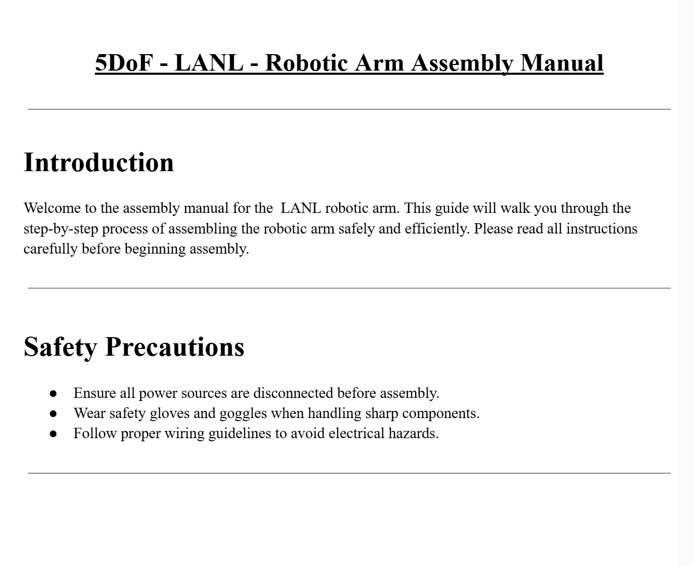
Assembly Instruction Manual
Overview
The assembly instruction manual provides a step-by-step guide for constructing the 5-DOF robotic arm
Ensures accurate assembly and optimal performance
Progress
Assembly instructions for the base and J1

Slide 40
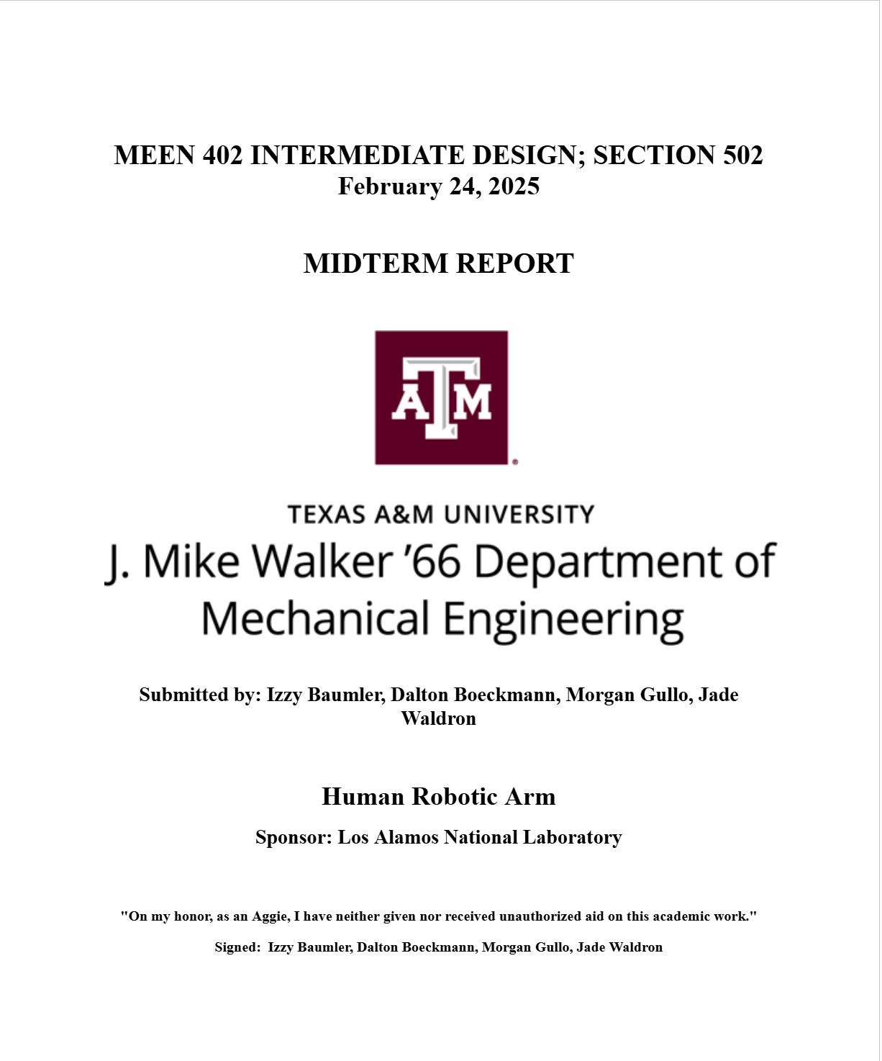
Final Report and Presentation
Overview
Discusses the final system design, operation, and validation
Intended for an audience unfamiliar with the project
Provides a narrative explanation of the project and the steps taken to complete it
Progress
Midterm report complete

Slide 41
Design Validation
Validation Method: Physical prototyping, assembly, and joint testing
Validation Focus: Physical limitations, Structural integrity, Actuator performance
Quantitative Metrics: Rotational speed (rad/s), torque (Nm), Fastener integrity
Current Progress:
Base assembly complete.
J1-J2 components 3D-printed (PLA)
Material/fastener selection complete
Successful R-Link/Upper Computer electrical setup

Slide 42
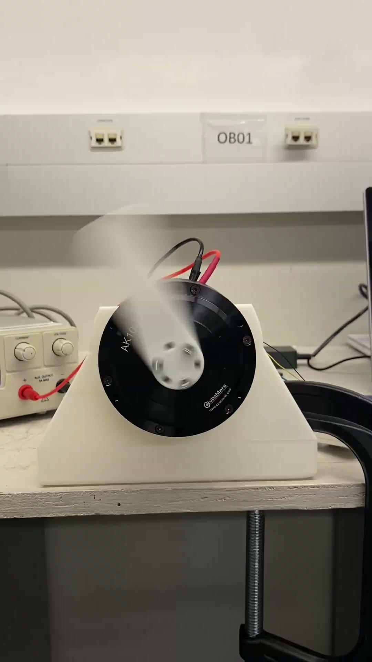
Design Validation
Testing: Joint position, speed, and torque validation via R-Link
Preliminary Results:
Successful Upper Computer to J1/J2 motor communication
Tolerance issues resolved (0.6 mm clearance)
Ongoing Arduino/CAN bus troubleshooting
Future Validation: Data compilation to verify joint frequency and performance benchmarks

Slide 43
Remainder of Embodiment Design
Evaluation of motor vibration and gear backlash, vibration dampening, Kp and Kd value adjustments
Target movement frequency of at least 1 Hz
Preliminary safety analyses for electrical hazards and material failures Implementation of safeguards: emergency stops, protective enclosures
Consideration of ergonomic issues for maintenance and installation
Development of an assembly manual
Cost tracking and adherence to project schedules
Focus on delivering a robust and successful outcome meeting project deliverables and customer needs

Slide 44
Timeline for Validation
Purpose
Outlines key phases to ensure the 5-DOF robotic arm meets performance and functional requirements
Progress is monitored through a google sheet
Phases
1. Construction and Fabrication (Weeks 1-3)
2. Assembly and Integration (Weeks 4-6)
3. Motor Programming and Control System Development (Weeks 7-11)
4. Testing and Calibration (Weeks 12-13)
5. Validation and Final Adjustments (Final 2 Weeks)

Slide 45
Future Concerns and Mitigation Plan
3 Future Concerns for the 5-DOF Robotic Arm
Mechanical wear and structural integrity
Software bugs and control system stability
Safety and human interaction risks

Slide 46
Future Concerns and Mitigation Plan
Mechanical Wear and Structural Integrity
Continuous motion can cause wear on bearings, joints, and fasteners, reducing speed and strength.
Mitigation strategy:
Use high-strength materials (PLA for prototype, PETG for production)
Increase infill density of high-strain components to enhance durability
Software Bugs and Control System Stability
Communication failures in the control system may cause unpredictable motion and loss of precision
Mitigation strategy:
Conduct extensive testing on the control system with each motor before full assembly
Safety and Human Interaction Risks
Risks include uncontrolled motion, accidental collisions, and system malfunctions
Mitigation strategies:
Implement an emergency stop mechanism in the design
Install a safety cage

Slide 47
Thank You!

